Slide 1
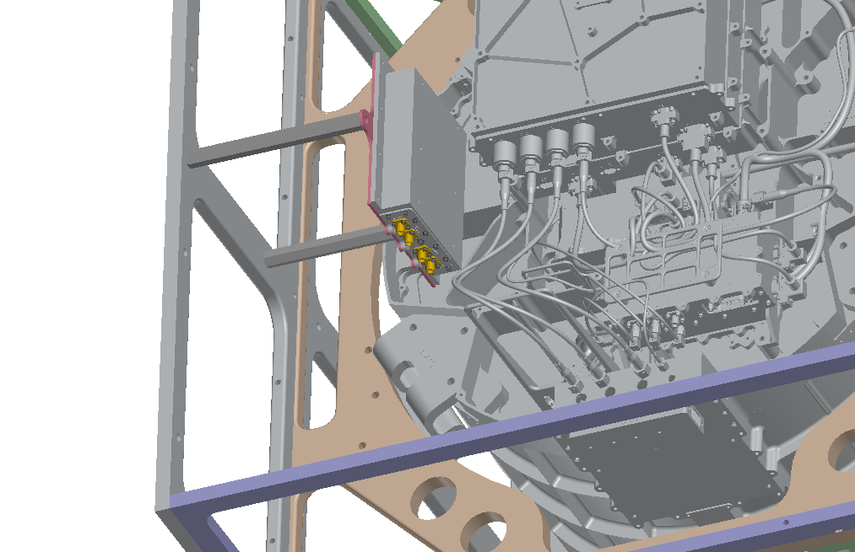
Laser and Temp Testing (Vacuum)
IE: Scott K.
ME: Chip
EE: Reid, Joel, Stacy
5/11
Laser testing hardware collected and ready for use
Plan to use 532nm – new optics to be procured
MGSE CSAs identified – Alec owning
Functional test at cold op and hot op – schedule to dictate outcome
Chamber qualification 1wk prior to test
Test set-up diagram – Tim
Determine what harnessing is missing for FM testing
Procedures to be released
Refining laser test set-up
Laser test set-up (Scott K.)
Power harness (3x – could be used through the S/C emulator) – Joel owner
Two main frames
1 mainframe Two power supplies
1 – survival heater
1 – instrument and DAB (interlocked)
2 mainframe – survival heater
Sudo redundant
Century+ to MHV harnesses
6’
18”
Harnessing for test campaign
Swap out optics tuned for 532nm and block IR (1064nm)
Can IDEX use SUDAs harnessing from TVAC? – Nat
How to verify Spectrum-Phython is ready for FM testing
Ethan to potentially add pusler stimulus to gather telemetry on instrument baseline –
What is the outgassing chamber qualification requirement – Jeff to answer
11/17/2022

Slide 2
Notes:

